Slide 1
Clustering Analysis
Maternal Mortality Indicator
In Colombia
Updated on July 3, 2020
By Andrés Segura

Slide 2
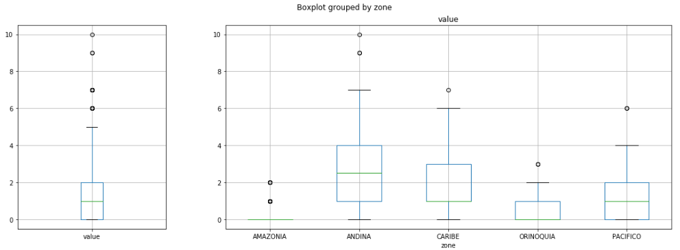
ANOVA
Split data by Regions

Slide 3
ANOVA
Variance Test
Result
The 𝐻0 (that the subsets have the same variance) is rejected, because the p-value is less than the alpha of 5% significance.
Kruskal-Wallis
Result
The 𝐻0 (that the subsets have the same variance) is rejected, because the p-value is less than the alpha of 5% significance.
ANOVA
Result
The 𝐻0 (that the subsets have the same variance) is rejected, because the p-value is less than the alpha of 5% significance.
Conclusion
Based on Variance, Kruskal-Wallis and ANOVA tests, it is concluded that the datasets do not have the same variance and therefore, it is not recommended to create 1 single model to represent the 5 regions of Colombia.

Slide 4
Clustering
K-Means
By Departments and By Municipalities

Slide 5
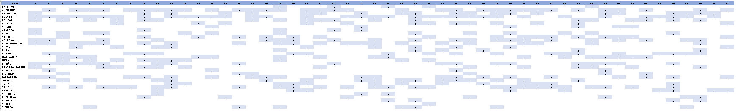
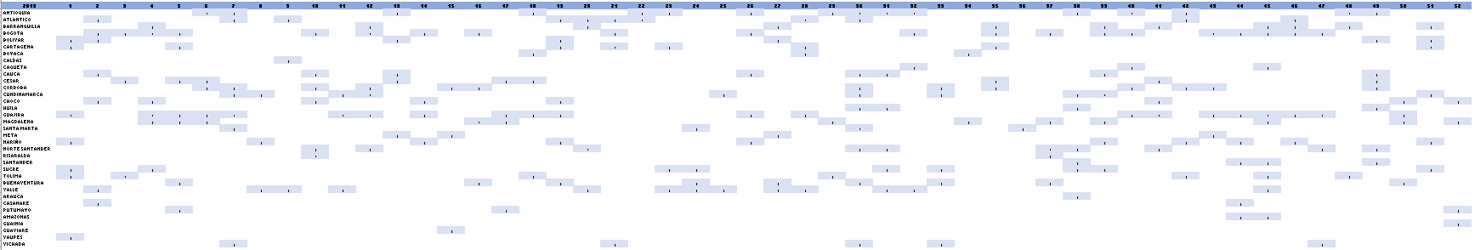
Data By Departments

Slide 6
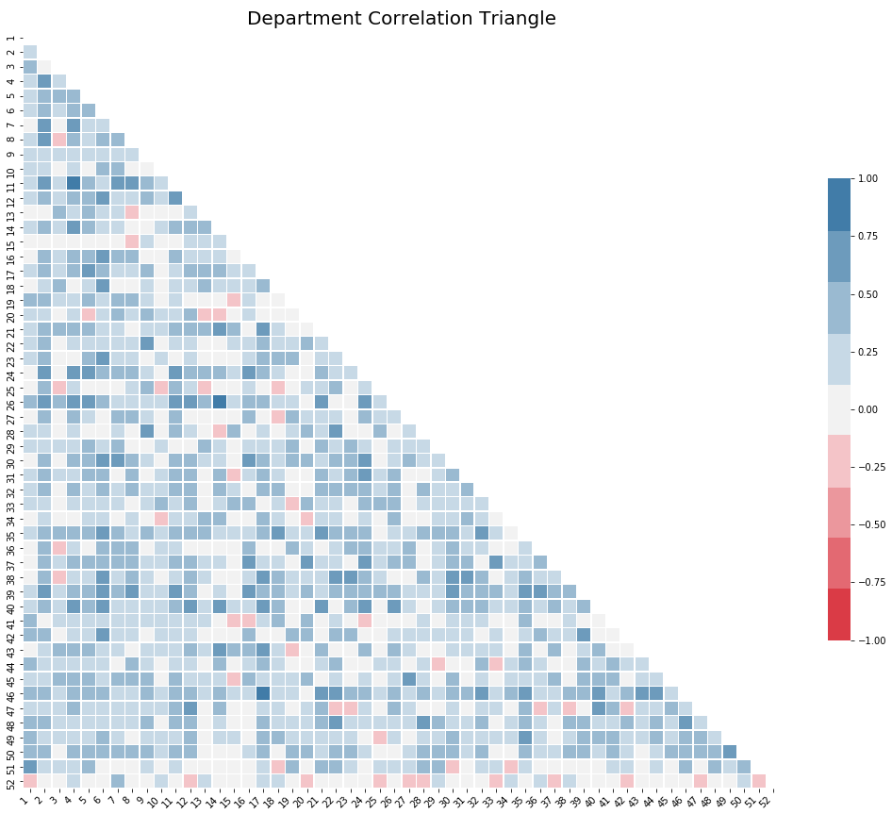
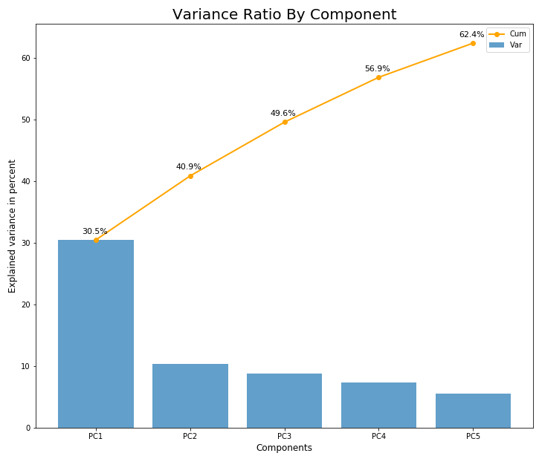
Data By Departments
Aggr. 2018 & 2019 data by weeks by departments
After Grouping, Data for:
31 Departments out of 32
1 Capital District
1 Exterior

Slide 7
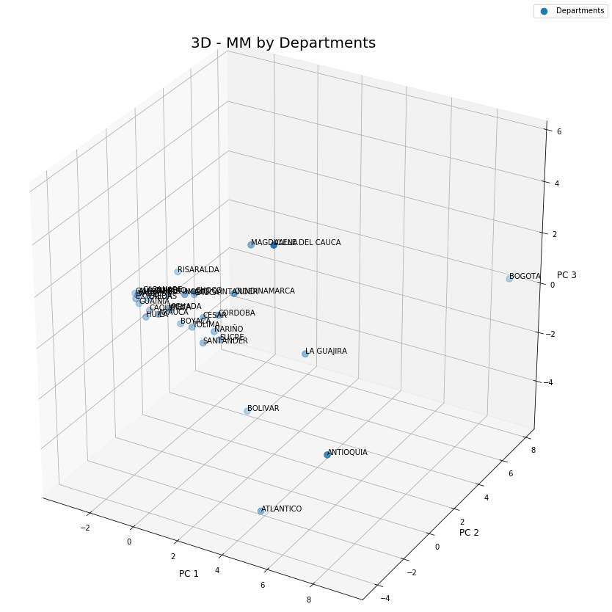
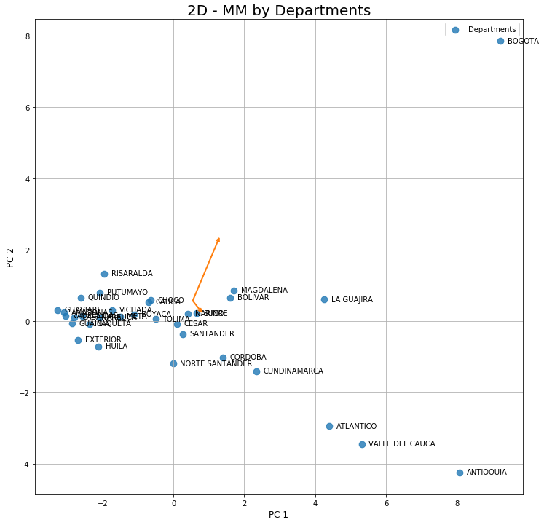
Data By Departments
Aggr. 2018 & 2019 data by weeks by departments

Slide 8
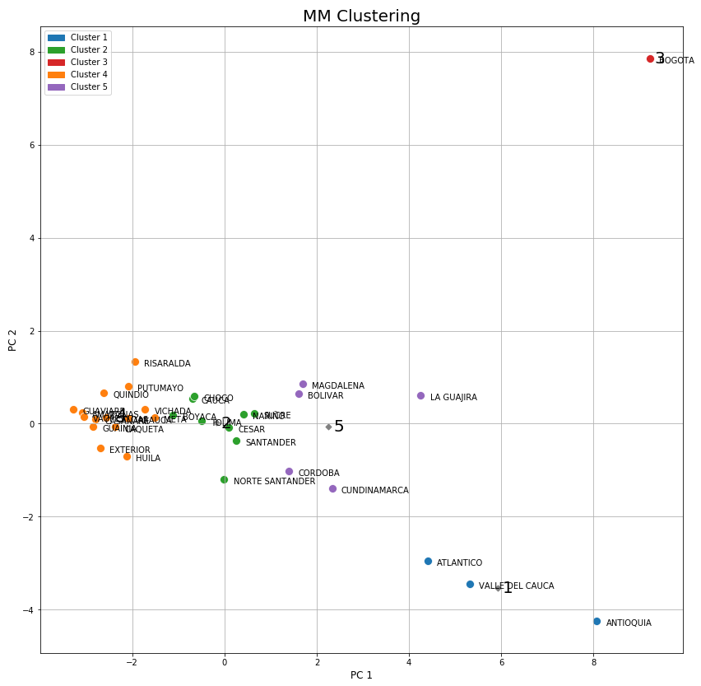
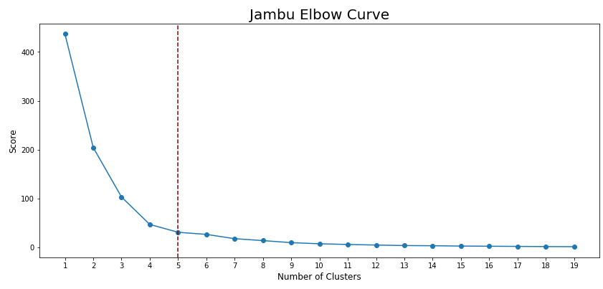
Data By Departments
Aggr. 2018 & 2019 data by weeks by departments

Slide 9
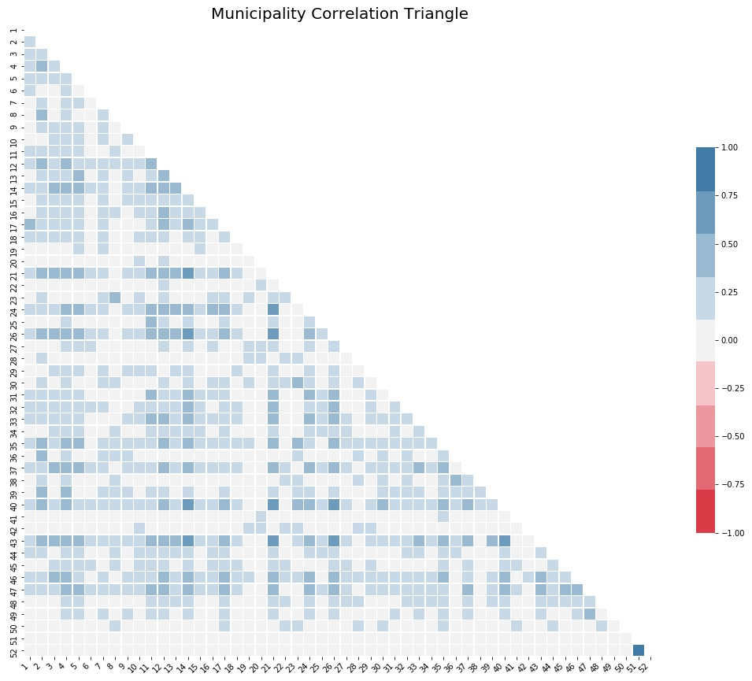
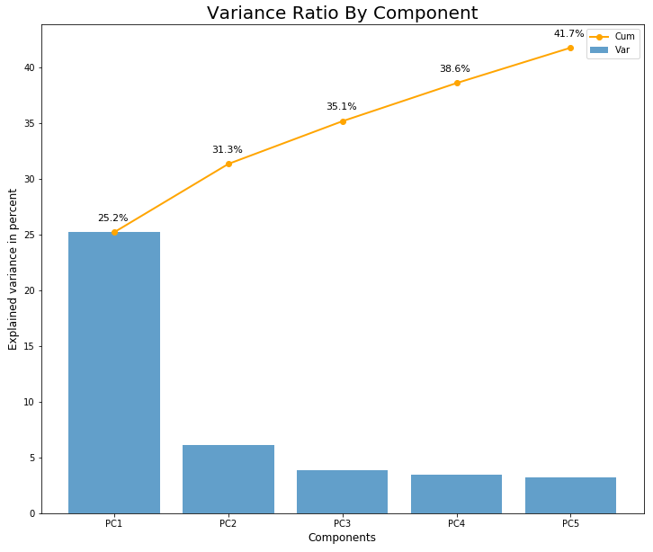
Data By Municipalities
Aggr. 2018 & 2019 data by weeks by municipalities
After Grouping, Data for:
313 Municipality out of 1.103

Slide 10
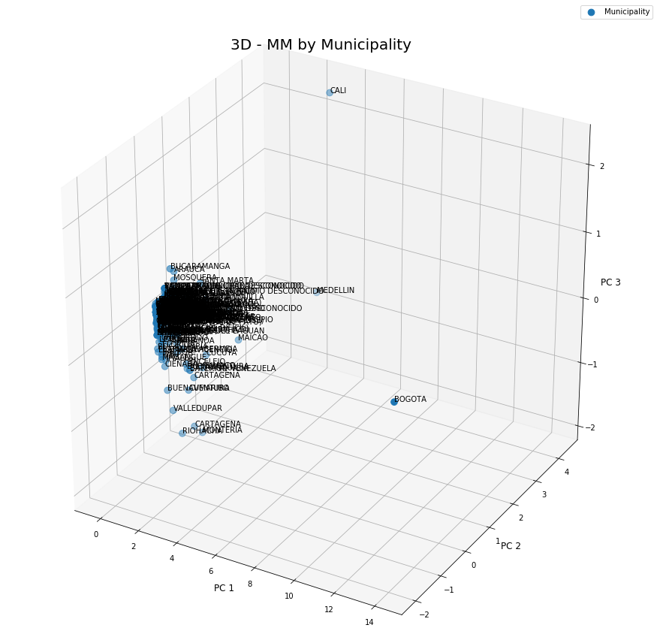
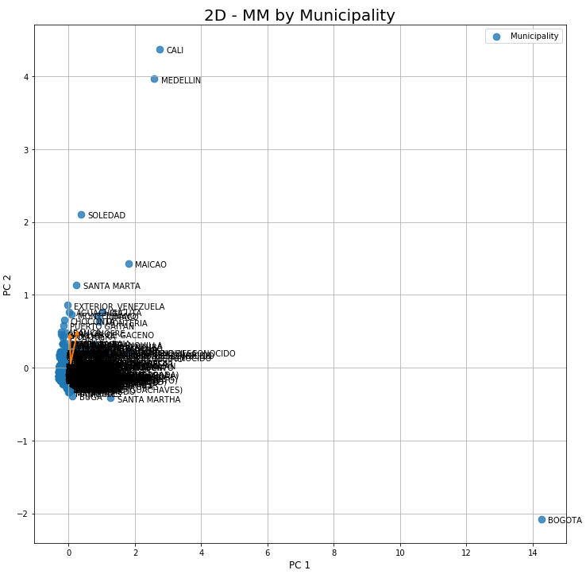
Data By Municipalities
Aggr. 2018 & 2019 data by weeks by municipalities

Slide 11
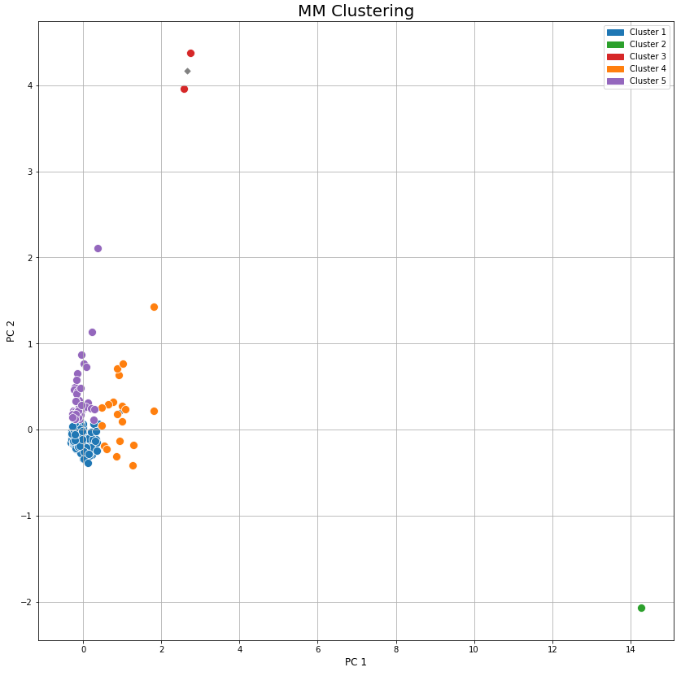
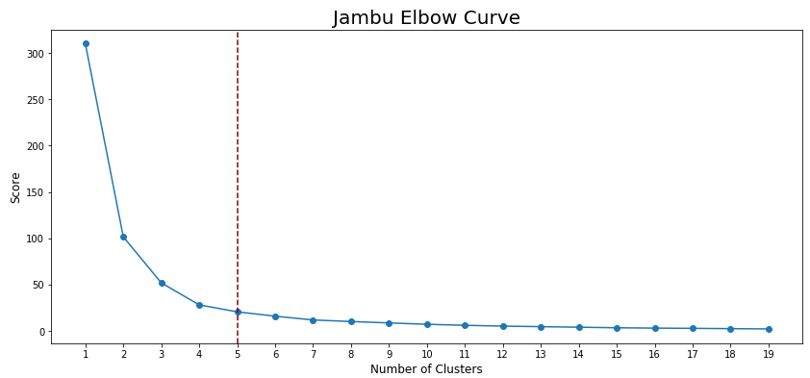
Data By Municipalities
Aggr. 2018 & 2019 data by weeks by municipalities

Slide 12
Let’s go to Jupyter Notebook…

